Slide 1

Real Solutions, Smarter Logistics
Real Smart Logistics (Thailand) Co., Ltd

Slide 2
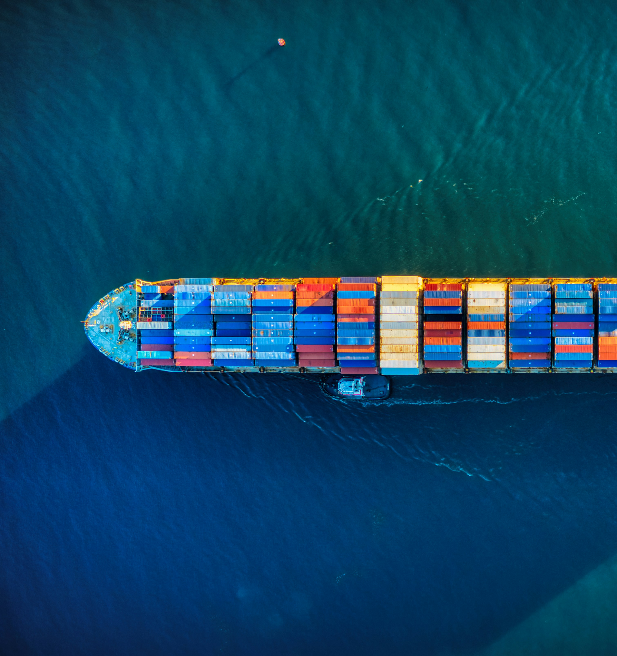
Real Smart Logistics (Thailand) Co., Ltd
1. About Us
Real Smart Logistics (Thailand) Co., Ltd
Established in 2025, is a leading comprehensive logistics service provider headquartered in Thailand with global reach. With our commitment to "Real Solutions, Smarter Logistics," we excel in providing integrated air, sea, and land transportation services, with particular strengths in sea freight, oversized cargo handling, and cold chain logistics. Our extensive network, cutting-edge technology, and professional expertise enable us to deliver tailored supply chain solutions across diverse industries.

Slide 3



Real Smart Logistics (Thailand) Co., Ltd
2. Our Strength
One-Stop Service
Worldwide Coverage
Professional Team
We provide comprehensive door-to-door logistics solutions, integrating services from cargo collection to final delivery through our professional team. A single dedicated customer service representative manages the entire process, eliminating the need for multiple service providers. This streamlined approach ensures seamless operations while improving efficiency and reducing costs.
Leveraging our strong global partner network, our service network extends to major ports, airports, and logistics hubs worldwide. Through cooperation with quality carriers, freight forwarders, and customs agents globally, we deliver comprehensive logistics services. Whether on major trade routes or emerging markets, we ensure safe and timely delivery of goods.
Our core team consists of industry experts with extensive international logistics experience. Team members are proficient in international freight operations and deeply familiar with port policies and regulations worldwide, enabling professional logistics consulting and solutions. The team adheres to a "customer-centric" philosophy, providing 24/7 support services.

Slide 4

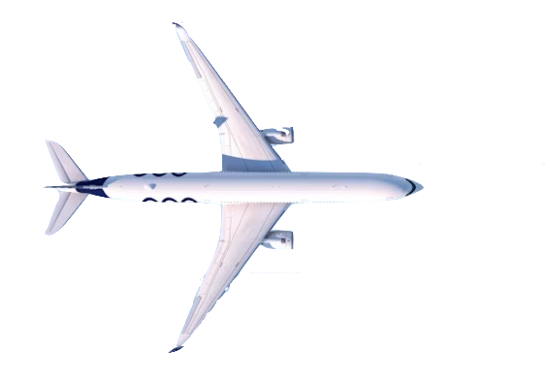
Real Smart Logistics (Thailand) Co., Ltd
3. Our Services
Air Freight Service
Sea Freight Service
Customs Clearance Service
Providing air freight services between major airports worldwide
Supporting diverse transportation solutions including direct flights and transit options
Special cargo air solutions for dangerous goods and valuable items
One-stop customs clearance service for air freight import and export
Full Container Load (FCL) and Less than Container Load (LCL) shipping services
Coverage of major global port routes
Flexible sailing schedules and premium space guarantee
Special container services: Open Top, Flat Rack, Platform, etc.
Real-time cargo tracking and sailing schedule inquiry services
Import and export customs clearance services
Integrated services for commodity inspection, declaration, and customs clearance
Related documentation services including permits, certificates of origin
Customs policy consulting and solution optimization
Assistance with customs inspection, detention, and other special situations

Slide 5
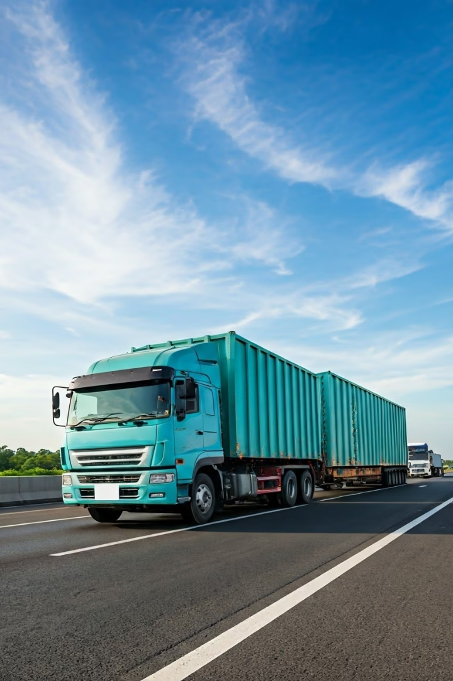
Real Smart Logistics (Thailand) Co., Ltd
Specialized Transport Solutions
Road Transport Service
OOG (Out of Gauge)
Container trucking services
Customized transportation solutions for oversized, overweight, and over-limit equipment
Factory pickup and door-to-door delivery services
Road transport network covering Thailand and neighboring countries
Professional heavy equipment loading and unloading team
Multimodal transportation transit services
Special vehicle and dedicated equipment support
Real-time vehicle positioning tracking system
Transportation route survey and optimization
Comprehensive risk assessment and security assurance
Cold Chain Transportation
End-to-end temperature-controlled logistics solutions
Professional handling of temperature-controlled cargo such as pharmaceuticals and food
Refrigerated container transportation services
Real-time temperature monitoring system
Comprehensive cold chain warehousing and distribution network

Slide 6
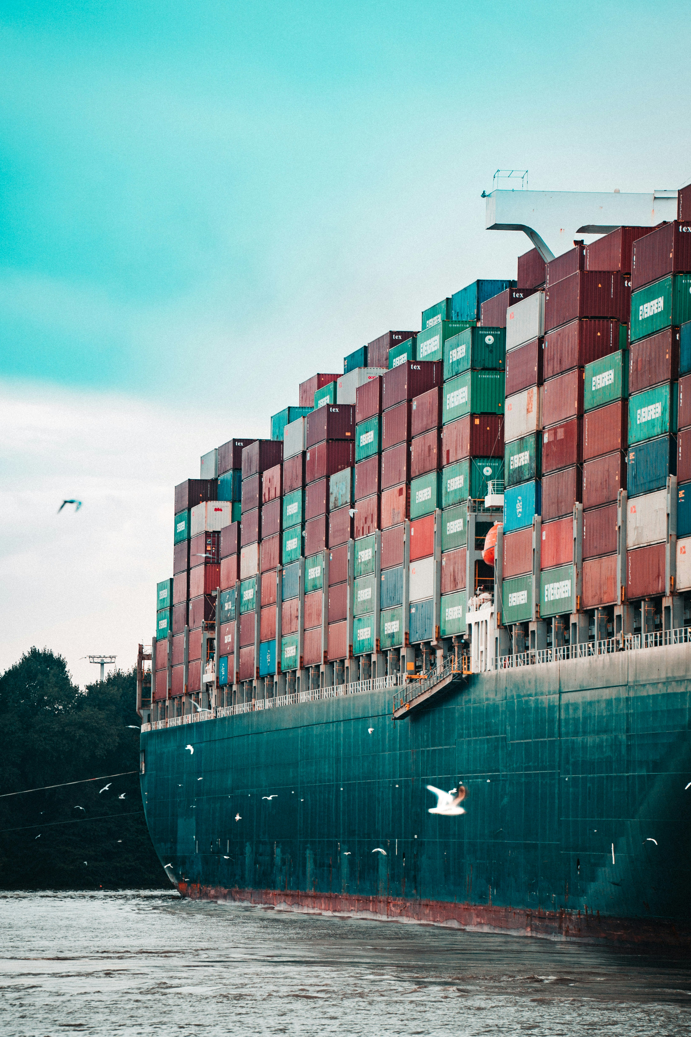



Real Smart Logistics (Thailand) Co., Ltd
4. Contact Us
Real Smart Logistics (Thailand) Co., Ltd
ADD：193/52 Lake Rajada Office, Unit 14A1, 14th Floor，Rachadapisek Rd., Klongtoey, Klongtoey, Bangkok 10110 Thailand
Call Us
+66 6-3940-5799
Email
june.ren_bkk@rssclogistics.com
WeChat
monv30
Line
jun.ren

